Slide 1
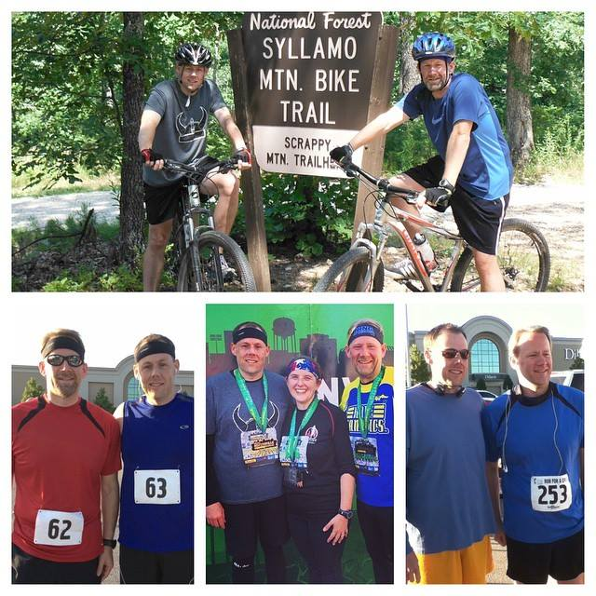
#NationalSiblingsDay
This past Friday marked a lessor known holiday, National Siblings Day. Siblings Day was created by Claudia Evart in 1997, a freelance paralegal from Manhattan, NY. Evart started the day after losing both her sister at an early age. It is a day of celebration and recognition for brothers and sisters around the world. The date of National Siblings Day is very important to its founder Claudia as it marks the birthday of her sister Lisette.
The siblings bonds are life-long relationships usually lasting from cradle to grave. It is usually the longest relationship of a person’s life and typically much longer than a mother’s and father’s relationship.

Slide 2
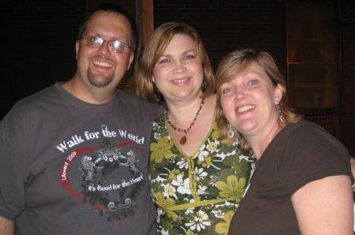
#NationalSiblingsDay

Slide 3
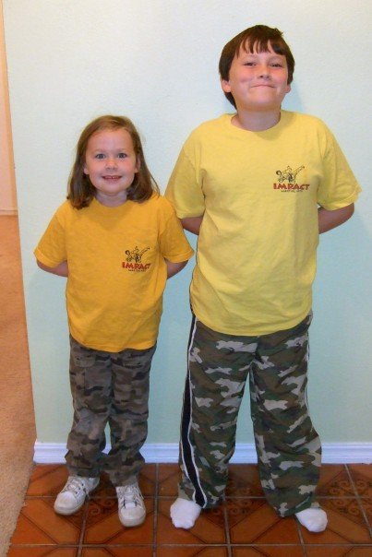
#NationalSiblingsDay

Slide 4
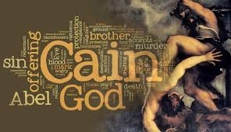

Slide 5
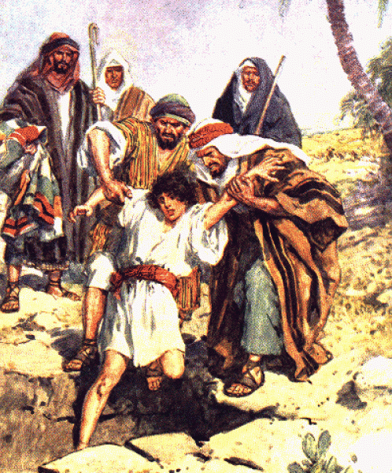
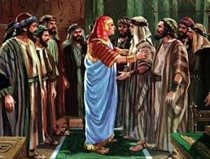

Slide 6
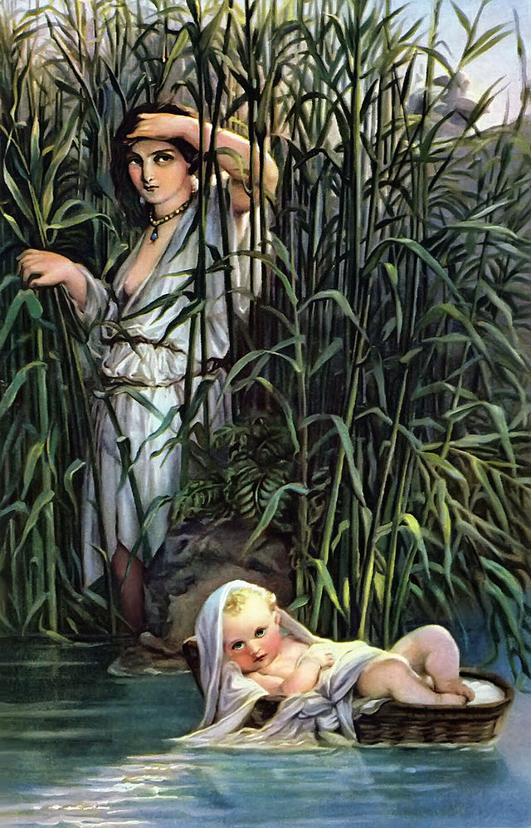
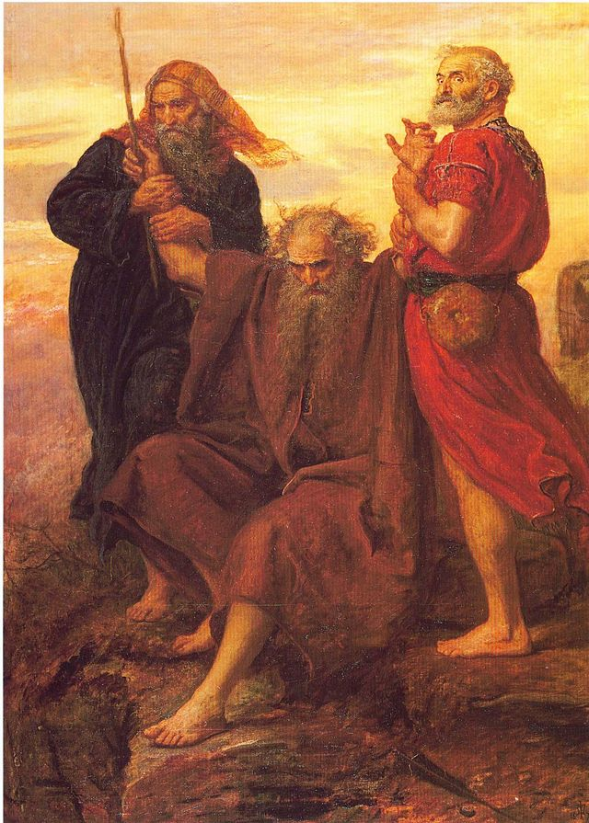

Slide 8
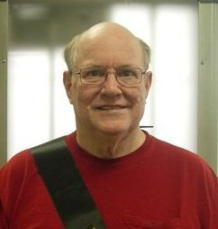
David Carson
1948-2010

Slide 9
Is it enough to simply put Family First?

Slide 10
The Heart of Family Life
Joshua 24:14-27

Slide 11
The Heart of Family Life
Choose What Will Be at the Heart of Your Family… (vs.15)
Choose to Put Away the Old Things… (vs.14)
Choose to Reaffirm that Choice… (vs.16-18)
Choose to Put Yourselves Under God’s Authority… (vs.19-22)
Choose to Be Held Accountable… (vs.23-27)

Slide 12
